Slide 1
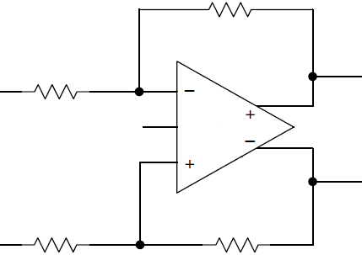
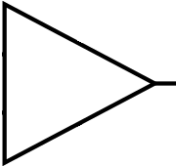
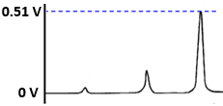

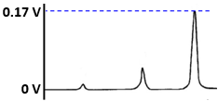
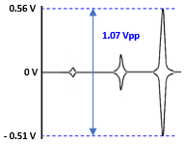
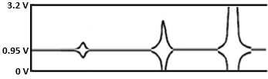
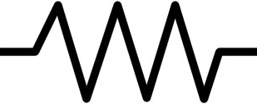
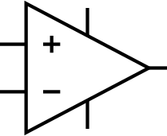
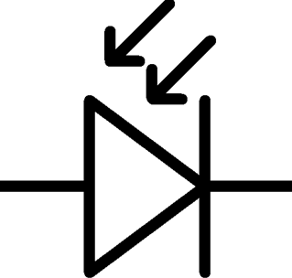

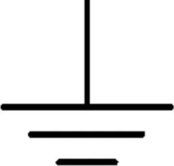
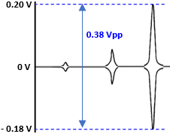
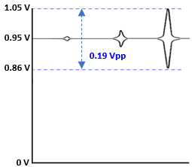
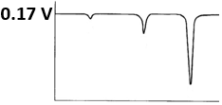
H-sensor Analog Circuit Block Diagram (Beta) 1 / 4
L-LPC Beta Version : Gain Plan → modification required parts are marked as red circle
ADC ch A path (x100 path) : overall gain = x 98.91
x100 / x1 gain difference
= x 89.7
Gain = 1
inverting
Gain = 1.0
inverting
2.2K
Gain = 3
Notch
Filter
Gain = 15.7
ADC3660
OPA827
INA128
OPA827
140
CH_A+
Gain = 1.1
Non-inverting
THS4561
CH_A-
OPA827
140
2.2K
23.2K
Single ended → differential
(Overall gain = 2.1)
7.3uA
/ 100 lx.
5V
0.17 V
/ 100 lx.
OPA380
0.95 V
VCM
Single ended → differential
(Overall gain = 2.1)
Gain = 1
inverting
Gain = 1.0
inverting
750
Gain = 1.05
Notch
Filter
Gain = 0.5
OPA827
INA128
OPA827
1.5K
CH_B+
Gain = 1.1
Non-inverting
THS4561
CH_B-
OPA827
1.5K
750
ADC ch B path (x1 path) : overall gain = x 1.1025

Slide 2

H-sensor Analog Frontend Gain Plan 2 / 4
L-LPC : Modified Analog Frontend Gain Plan
1.45V
Vin+
0.5Vpp
0.95V
Base line voltage : max. 1.0V @laser beam max intensity
typ. 0.75V
0.45V
1.45V
Vin-
0.95V
0.5Vpp
1.0V
0V
0V
0.45V
0V
-1.0V
-1.0V
1.0V
NA (x 1.0) or
49.9K (x 2.0)
Upper half of ADC FS is being used
ADC (pos) : 0x0000 - 0x7FFF (valid data)
ADC (neg) : 0x8000 - 0xFFFF (treated as 0)
Vdiff
0V
7.3uA
/ 100 lx.
x 1.0
x 1.0
-1.0V
5V
5V
5V
5V
OPA380
INA128
1.5K
ADC3660
OPA827
OPA827
5V
-5V
-5V
-5V
Vin+
Vo = 0.1~4.4V
Vo = -2~2V
Vo = -3.6~3.6V
0.95V
x 1.0
-5V
Vin-
1.0V
1.0V
5V
1.5K
VCM (0.95V)
OPA827
THS4561
1. ADC3660 (16-bit ADC)
- input FS : 3.2Vpp, 48.8uV
- Vref : 1.6V
2. L-LPC Operating Range (used range)
- input range : 2.0Vpp
- Vin+/- : 0.95V ± 0.5V
(0.45 – 1.45V)
0V
0V
x 16 (CH_A)
x 0.5 (CH_B)
-5V
Vo = -2~2V
Single ended → Differential
- overall gain = x 2.0
1.0V
Vin+ 1.75V 1.45V 0.95V 0.45V 0.25V
Vin- 0.15V 0.45V 0.95V 1.45V 1.65V
Vdiff +1.60 +1.00 0 -1.00 -1.60
ADC 0x7FFF 0x5000 0x0000 0xB000 0x8000
(32767) (20480)
0V

Slide 3

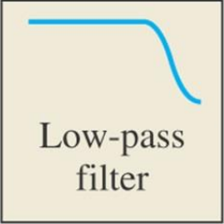
H-sensor Analog Frontend Block Diagram 3 / 4
Base line voltage monitoring
1. Laser intensity monitor & correction
2. Sample turbidity monitor & correction
Zynq
FPGA
ADC
(12-bit)
Base line voltage : max. 1.0V
typ. 0.75V
ADC ch A path : overall gain = x 64
49.9K (x 2.0)
Single ended → differential
(Overall gain = 2.0)
ADC3660
x 1.0
1.5K
5V
5V
5V
1.0V
Notch
Filter
x 1.0
5V
OPA827
INA128
OPA827
93.1
CH_A+
0V
-5V
-5V
Vo = -3.6~3.6V
-5V
CH_A-
Vo = -2~2V
-5V
1.45V
7.3uA
/ 100 lx.
93.1
1.5K
0.5Vpp
5V
5V
Vin+
x 1.0
THS4561
0.95V
OPA380
OPA827
x 16
0.45V
0V
VCM (0.95V)
NA (x 1.0)
-5V
THS4561
1.45V
x 1.0
Vo = -2~2V
x 0.5
Vin-
Vo = 0.1~4.4V
5V
-1.0V
1.5K
0.95V
0.5Vpp
5V
5V
0.45V
INA128
Notch
Filter
x 1.0
3K
5V
CH_B+
OPA827
OPA827
1.0V
-5V
-5V
-5V
Vdiff
Vo = -2~2V
Vo = -3.6~3.6V
-5V
CH_B-
0V
3K
1.5K
-1.0V
5V
0V
1.0V
x 1.0
OPA827
1.0V
Vin+ 1.75V 1.45V 0.95V 0.45V 0.25V
Vin- 0.15V 0.45V 0.95V 1.45V 1.65V
Vdiff +1.60 +1.00 0 -1.00 -1.60
ADC 0x7FFF 0x5000 0x0000 0xB000 0x8000
(32767) (20480)
-1.0V
0V
-5V
0V
Vo = -2~2V
ADC ch B path : overall gain = x 1.0

Slide 4
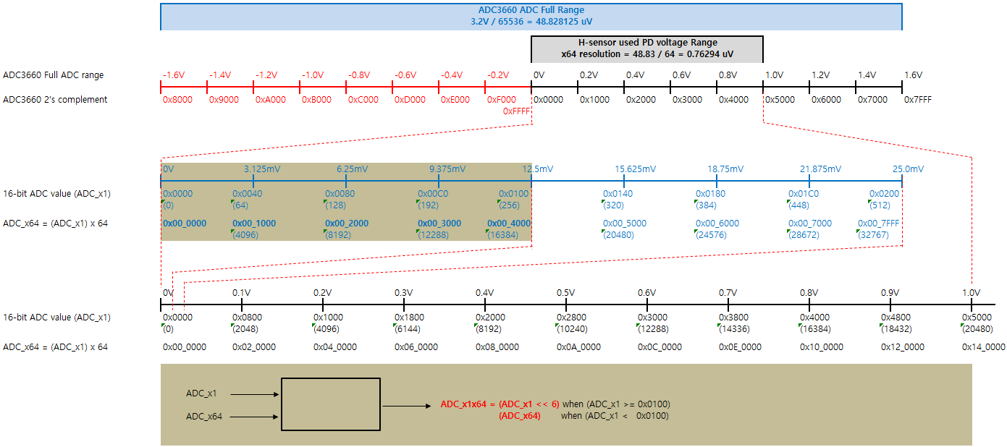
H-sensor Analog Frontend Block Diagram 4 / 4
H-sensor : Analog Frontend Signal Treatment : ADC3660

Slide 5
H-sensor Analog Frontend Block Diagram 4 / 4
H-sensor : Analog Frontend Signal Treatment : ADC3660
ADC full range
( Resolution = 3.2V / 65536 = 48.83 uV )
H-sensor ADC used range
-1.6V
-0.8V
0V
12.5mV
0.8V
1V
1.6V
1) H-sensor PD output range : 0 ~ 1000mV
2) ADC 전압 range 를 2 단계로 구분
a) X1 영역 : 12.5 ~ 1,000 mV 영역 (Gain = 1 )
- resolution = 3.2V/65536 = 48.83 uV
b) X64 영역 : 0 ~ 12.5 mV 영역 (Gain = 64)
- resolution = 3.2V/65536/64 = 0.763 uV
3) X1 영역 : ADC_x64 = (ADC_x1) x 64
- X1 전압 범위 : 12.5mV ~ 1,000mV
ADC_x1 → 256(0x0100) ~ 20,480(0x5000)
ADC_x64 → 16,384(0x00_4000) ~ 1,310,720(0x14_0000)
4) X64 영역 : ADC_x64
- X64 전압 범위 : 0mV ~ 12.5mV
gain 64 반영후 : 0mV ~ 800mV
ADC_x64 → 0(0x00_0000) ~ 16,384(0x00_4000)
5) FPGA 상에서 PD 전압 ADC 구성 방법
if (ADC_x1 > 0x100)
ADC_PD = ADC_x1 << 6 ;
else
ADC_PD = ADC_x64 ;
PD output
X64
X1
12.5mV x 64 = 800mV
Scaling 일치를 위해 x64
X64 영역
X1 영역
0x00_0000
0x00_4000
0x14_0000
H-sensor PD voltage = ADC_val x 0.763 uV
S/W display voltage range = 0 ~ 10 V = (H-sensor PD voltage) x 10
0V
10V
unused
X1
ADC_PD (4 byte)
X64
ex) 100 mV : ADC_x1 = 2,048 (0x0800)
898 mV : ADC_x1 = 18,391 (0x47D7)
1 mV : ADC_x1 = 20 (0x0014)
ADC_x64 = 1,310 (0x051E)
0
0
0
0
0
0
0
0
0
0
0
0
0
0
1
0
0
0
0
0
0
0
0
0
0
0
0
0
0
0
0
0
0
0
0
0
0
0
0
0
0
0
0
1
0
0
0
1
1
1
1
1
0
1
0
1
1
1
0
0
0
0
0
0
0
0
0
0
0
0
0
0
0
0
0
0
0
0
0
0
0
0
0
0
0
1
0
1
0
0
0
1
1
1
1
0

